Slide 1
Data Structures
CH1 Basic Concepts
Prof. Tai-Lang Jong
Office: Delta 928
Tel: 42577
email: tljong@mx.nthu.edu.tw
Spring 2021

Slide 2
Outline
1.1 Overview: System Life Cycle
1.2 Object-Oriented Design
1.3 Data Abstraction and Encapsulation
(1.4 Basics of C++)
1.5 Algorithm Specification
(1.6 Standard Template Library)
1.7 Performance Analysis and Measurement

Slide 3
System Life Cycle
Large-scale computer programs = systems containing many complex interacting parts
Five phases of system developing process
Requirements
Analysis
Design
Refinement and coding
Verification
Requirements
Analysis
Design
Refinement
Coding
Verification

Slide 4
Requirements
Clarify problem specifications
Input
What are given
Output
What must be produced
Initially vague → more precise
Requirements
Analysis
Design
Refinement
Coding
Verification

Slide 5
Analysis
Break down the problem
Into manageable pieces
Also known as divide and conquer
Two approaches
Bottom-up (not good)
Top-down (better)
Requirements
Analysis
Design
Refinement
Coding
Verification

Slide 6
Bottom-up Analysis
Issues
Too early emphasis on low-level details
Lack of prior planning and a big picture
Risks and difficulties
Resulting system can have many loosely connected and error-ridden segments ☹
Unpractical for tackling large-scale, complex problem

Slide 7
Top-down Analysis
Strategies
Start from a high-level plan
Breaking a problem down into manageable pieces
Subsequently refining the plan
Gradually taking into account low-level details
Advantages
→Necessary for tackling large-scale, complex problem

Slide 8



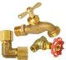
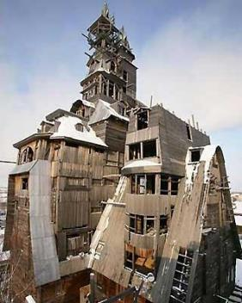



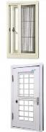
Risks of Bottom-Up

Slide 9
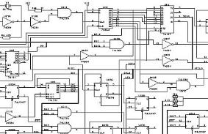
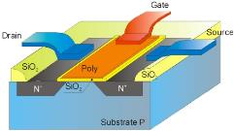

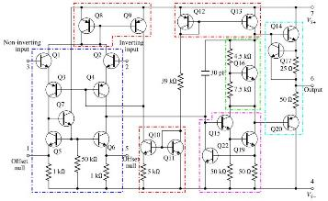

Difficulties of Bottom-Up
Please imagine analyzing a smartphone bottom-up
Things become complicated

Slide 10
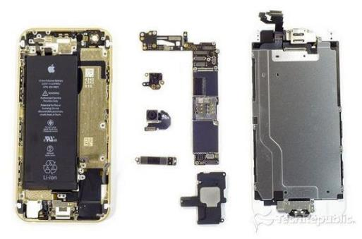
Benefits of Top-Down
Now let’s alternatively analyze a smartphone top-down
Software
Case
Processor
Screen
Battery
Cameras
Memory

Slide 11
Design
Identify
Data objects needed
Operations performed on the data types
Implementation (Not decided in this phase)
Produce implementation-independent results
Abstract data types
Algorithm specifications
Requirements
Analysis
Design
Scheduling system for NTHU
Data objects
Students
Name, ID, major, and phone #
Courses
Professors
Operations
Inserting, removing, and searching
Refinement
Coding
Verification

Slide 12
Refinement and Coding
Decide implementation
Representations for objects
Algorithms for operations
Algorithm and object representations affect the efficiency of each other
Design the algorithms that are independent of data objects first
Good design can absorb changes found in this stage easily
Requirements
Analysis
Design
Refinement
Coding
Verification

Slide 13
Verification
Three techniques
Correctness proofs
Testing
Debugging
Requirements
Analysis
Design
Correctness Proofs
Testing
Refinement
Coding
Debugging
Verification

Slide 14
Verification (Cont'd)
Correctness proofs
Formal method
Typically required for individual algorithm
Select proven correct algorithms can reduce errors
Not easily achievable for the whole program

Slide 15
Verification (Cont'd)
Testing
Run a program against possible inputs
Check correctness
Check performance (e.g., execution time)
Coverage – a metric for assessing the completeness of testing
Testing inputs should be developed to cover as many percentages of codes as possible
E.g., all the cases within a switch statement should at least be touched

Slide 16
Verification (Cont'd)
Debugging
Removal of errors found by correctness proofs & system tests
Well-documented and well-structured program eases debugging
A large undocumented, unstructured “spaghetti” code is a programmer’s nightmare.

Slide 17
Outline
1.1 Overview: System Life Cycle
1.2 Object-Oriented Design
1.3 Data Abstraction and Encapsulation
(1.4 Basics of C++)
1.5 Algorithm Specification
(1.6 Standard Template Library)
1.7 Performance Analysis and Measurement

Slide 18
Programming Paradigms
Non-structured
Structured
Object-oriented
More disciplines are imposed on programmers

Slide 19
Non-Structured Programming
Characteristics
Sequentially ordered commands
Lines are numbered or labeled
Unrestricted jump/branch to any line
Pros
Extremely skillful programmers can find tricky methods to produce high performance or compact code
Cons
Encourage spaghetti codes
Poor maintainability
Difficult in building large programs (poor scalability)
Notes:
Cobb, Gary W. (1978). "A measurement of structure for unstructured programming languages". ACM SIGSOFTSoftware Engineering Notes 3 (5): 140–147.

Slide 20
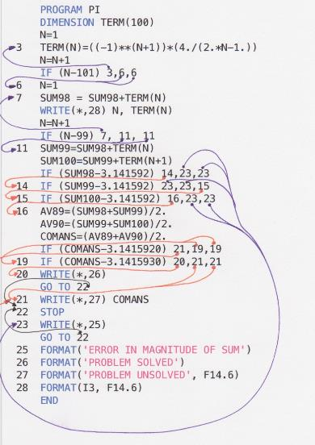
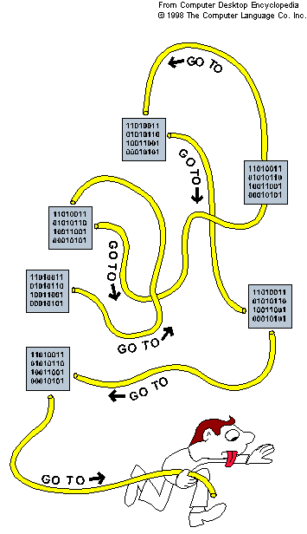
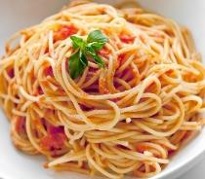
Spaghetti Code
FORTRAN’s three-way arithmetic IF
Jump to one of three locations in the program depending on the whether expression was negative, zero, or positive.
https://craftofcoding.wordpress.com/2013/10/07/what-is-spaghetti-code/
http://www.quora.com/What-does-spaghetti-code-actually-look-like

Slide 21
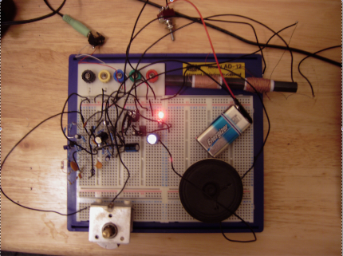
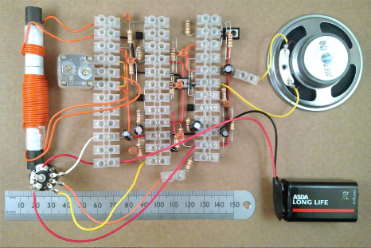

Spaghetti Circuit
← Spaghetti circuit
↓ Clean circuit
What do you think the possible function of these circuits is?
http://www.quora.com/What-does-spaghetti-code-actually-look-like

Slide 22
Structured Programming
Basic structures
All programs can be equivalently transformed to those use only the above three structures
Statement
True
Condition
False
False
Condition
Statement
True
Statement(s)
Statement(s)
Statement(s)
Statement
Sequence
Selection (or choice)
If(condition) {…} else {…}
Repetition (or looping)
While(condition) {…}

Slide 23
Structured Programming (Cont’d)
Pros
Easy to understand
Easy to maintain
Easy to analyze
Pure structured languages strictly disallow C/C++’s
goto
break
continue

Slide 24
Structured Programming (Cont’d)
Compared with non-structured programming
Structured programming restricts programmers' freedom
Structured programming prevents spaghetti codes
Structured programming does not change programmability
Whatever problem non-structured programming can solve can also be done using structured programming (and vice versa)

Slide 25
Structured Programming (Cont’d)
C and C++ are structured languages but NOT pure ones
goto, break, continue statements are allowed
goto statement is notorious but not always bad
See the example on the right
for(x=0; x<1000; x++){
for(y=0; y<1000; y++){
for(z=0; z<1000; z++){
if( g(x, y, z) > 0 ){
cout << x << “, ” << y << “, ” << z;
goto END;
}
}
}
}
END:
Code snippet for searching an integer solution of g(x, y, z)>0 in a brute force way. In this example, it is convenient to use goto to leave the nested loops.

Slide 26
Object-Oriented Programming
Philosophy of divide-and-conquer is the same as structured programming
How a project should be decomposed is changed
Decomposition methods
Algorithmic (functional) decomposition is used for the structured programming method
Object-oriented decomposition is used for the object-oriented programming method

Slide 27
Algorithmic/Functional Decomposition
Used by structured programming
View software as a process
Decompose software into modules that represent steps of the process
In C, the modules are functions
Compute-centric perspective
Data structures are a secondary concern, which is addressed after project decomposed into function modules

Slide 28
Object-Oriented (OO) Decomposition
Used by object-oriented programming
View software as a set of well-defined objects
Objects model entities in the application domain
e.g., students, courses, and teachers in a course scheduling system
Objects interact with one another to form software system
Algorithmic or functional decomposition is addressed after the system has been decomposed into objects

Slide 29
OO Decomposition (cont'd)
Pros
Encourage the reuse of software
Software becomes more flexible that can evolve as requirements change
More intuitive because objects naturally model entities in the application domain

Slide 30
Definitions
Object
Entity that has a local state and performs computations
i.e., a combination of data and procedural elements (operations)
Object-oriented programming
Method of implementation in which …
Objects are the fundamental building blocks
Each object is an instance of some type (or class)
Classes are related to each other by inheritance relationships

Slide 31
Definitions
A language is said to be an object-oriented language if
It supports objects
It requires objects to belong to a class
It support inheritance
A language is said to be merely an object-based language if it supports the first two features but does not support inheritance

Slide 32
Evolution of Programming
Four generations of higher level languages
1st Generation. FORTRAN, etc.
Salient feature of evaluating mathematical expression
2nd Generation. C, Pascal, etc.
Emphasis on effectively expressing algorithm
3rd Generation. Modula, etc.
Introduce of the concept of abstract data types (ADT)
4th Generation. Smalltalk, Objective C, C++, etc.
Emphasis on inheritance between ADTs

Slide 33
History of C++
C++ was designed by Bjarne Stroustrup of AT&T Bell Lab in early 1980s to incorporate OO paradigm into C
C has the good properties:
Efficient (hardware)
Flexible
Available (C compilers)
C++ improves on & goes beyond C:
Class, object, ADT
Functions and class templates
Inheritance, polymorphism

Slide 34
Outline
1.1 Overview: System Life Cycle
1.2 Object-Oriented Design
1.3 Data Abstraction and Encapsulation
(1.4 Basics of C++)
1.5 Algorithm Specification
(1.6 Standard Template Library)
1.7 Performance Analysis and Measurement

Slide 35
Definition
Data Encapsulation (or Information Hiding) (封裝)
Conceal the implementation details of a data object form the outside world
Data Abstraction (抽象化)
Separation between the specification of a data object and its implementation

Slide 36

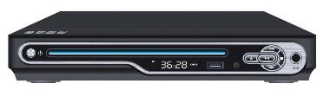
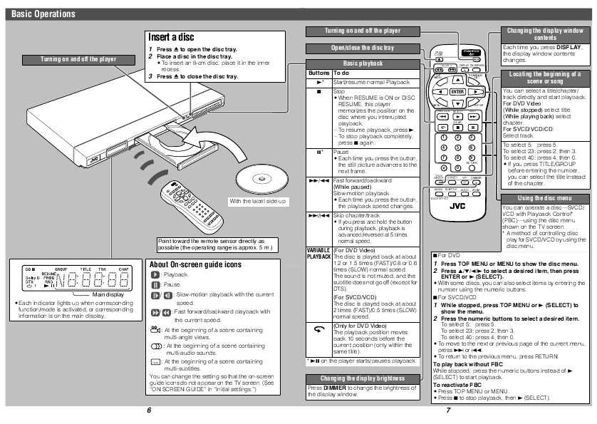
DVD Player Analogy
Encapsulation ―the buttons and remote control
The only interfaces exposed to users
Hide and protect internal (vulnerable, dangerous, and proprietary) design from users
Abstraction ― the user manual
Only specify what the function of each button is
How the player achieve the function is not mentioned nor restricted

Slide 37
Definition
Data Type =
Collections of objects + Operations on the objects
Abstract Data Type (ADT)
Object
Operation
Specification
Representation
Specification
Implementation

Slide 38
Data Types in C++
Predefined (built-in) types
Fundamental types
char
int
float
double
Modifiers
short
long
signed
unsigned
Derived types
Pointer (*)
Reference (&)
Aggregate types
Arrays
struct
class
User-defined types
struct
class

Slide 39
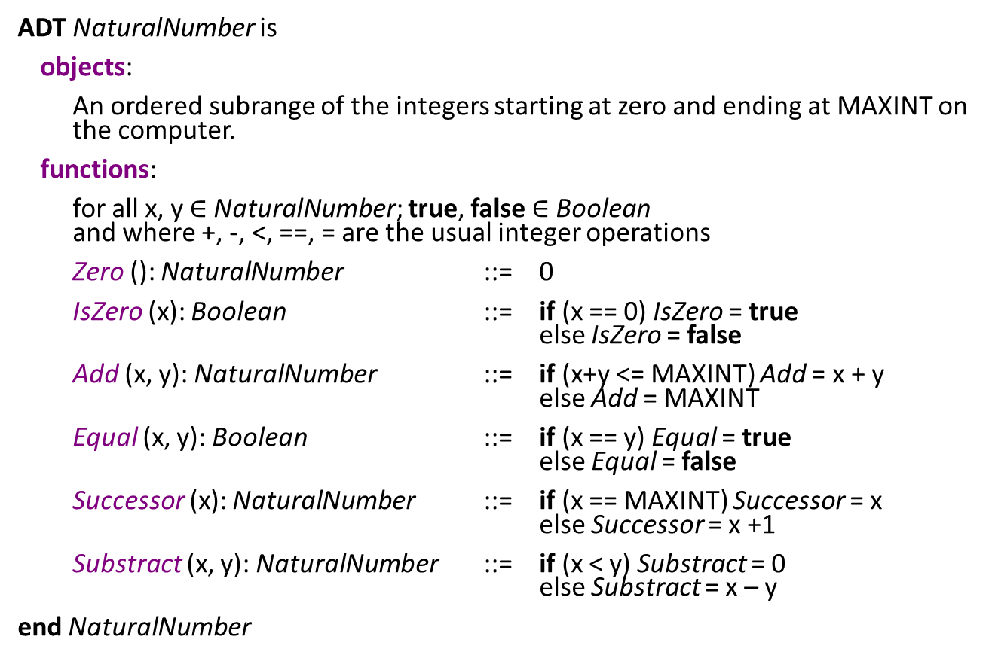
ADT Example: NaturalNumber
ADTNaturalNumber is
objects:
An ordered subrange of the integers starting at zero and ending at MAXINT on the computer.
functions:
for all x, y $∈$NaturalNumber; true, false$∈$Boolean and where +, -, <, ==, = are the usual integer operations
Zero (): NaturalNumber ::= 0
IsZero(x): Boolean ::= if(x == 0) IsZero = true else IsZero = false
Add (x, y): NaturalNumber ::=if(x+y<= MAXINT) Add = x + y else Add = MAXINT
Equal (x, y): Boolean::=if(x == y) Equal = true else Equal = false
Successor (x): NaturalNumber::= if (x == MAXINT) Successor = x else Successor = x +1
Substract(x, y): NaturalNumber ::= if (x < y) Substract = 0 else Substract = x – y
endNaturalNumber

Slide 40
ADT Example: NaturalNumber
objects:
An ordered subrange of the integers starting at zero and ending at MAXINT on the computer.
functions specification:
Format | Return Type | Behavior
Zero () | NaturalNumber | 0
IsZero (x) | Boolean | if (x == 0) return true else return false
Add (x, y) | NaturalNumber | if (x+y <= MAXINT) return x + y else return MAXINT
Equal (x, y) | Boolean | if (x == y) return true else return false
Successor (x) | NaturalNumber | if (x == MAXINT) return x else return (x+1)
Substract (x, y) | NaturalNumber | if (x < y) return 0 else return (x-y)

Slide 41
Advantages of Encapsulation and Abstraction
Simplify software development
Ease testing and debugging
Enable reusability
Support modifications to the representation of a data type

Slide 42
Simplify Software Development
Data abstraction facilitates decomposition of complex task of developing SW into simpler subtasks.
Consider developing a course scheduling program for NTHU – top-down review results in
Three data types: S (student), T(teacher), C(course) (or A,B,C)
Additional code of using them (called Glue)
S
T
A
B
C
C
Glue
Glue

Slide 43
With or Without Data Abstraction
One can either adopt ADTs or directly dive into coding (without data abstraction)
ADTs are identified
vs.
A monolithic program
ADT Teachers
T
S
Searching a course
Deleting a course
Adding a course
Glue
C
ADT Courses
ADT Students

Slide 44
Two Scenarios
With encapsulation and abstraction
Scenario 1: Four programmers team
They can parallelly work on data types A, B, C, (or in the example, S, T, C) and Glue
No one need to know how another one implement their portion of code
More concentration and less interference (especially when the project is large)
Scenario 2: A single programmer
Focus on A, B, C, and Glue one at a time
Less things need to be kept in mind at a time

Slide 45
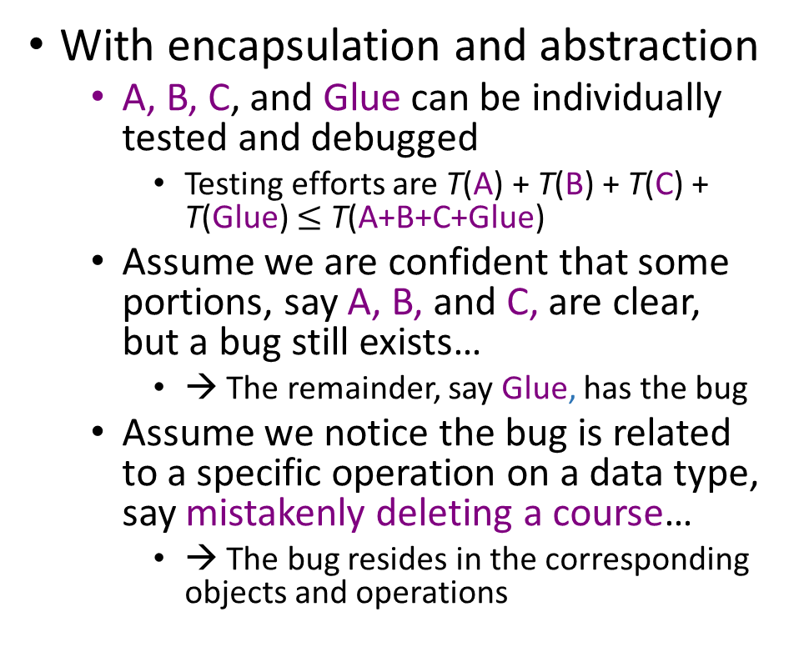
Testing and Debugging
With encapsulation and abstraction
A, B, C, and Glue can be individually tested and debugged
Testing efforts are T(A) + T(B) + T(C) + T(Glue) $≤$T(A+B+C+Glue)
Assume we are confident that some portions, say A, B, and C, are clear, but a bug still exists…
→ The remainder, say Glue, has the bug
Assume we notice the bug is related to a specific operation on a data type, say mistakenly deleting a course…
→ The bug resides in the corresponding objects and operations
w. data abstraction
No data abstraction

Slide 46
Reusability
When we (or other people) develop
Textbook ordering program
Dorm allocation program
NTHU-NCTU tournament program
…

Slide 47

Modifications
ADTs lead to information hiding
Implementation of a data type is invisible to users and the rest of the program
Ease changing (e.g., upgrade) a data type without rewriting the entire program or affecting any users
Allow us to start from a quick implementation then progressively refine the program
Even if we need to modify the interface of a data type
We can systematically identify the required modifications to the other parts

Slide 48
Overhead of Adopting ADT
Execution time overhead
Accessing data through interfacing operations is potentially slower than directly accessing them
Memory space overhead
Every object maintains a table specifying its operations
Coding is more tedious
Therefore, C (not C++) is still widely used for programming the following things
Operating systems
Performance sensitive systems
Resource constrained systems

Slide 49
Outline
1.1 Overview: System Life Cycle
1.2 Object-Oriented Design
1.3 Data Abstraction and Encapsulation
1.4 Basics of C++
1.5 Algorithm Specification
(1.6 Standard Template Library)
1.7 Performance Analysis and Measurement

Slide 50
1.4 Basics of C++
C++ is a “better” C, implying
C and C++ have a lot of features in common
C++ has a number of features not associated with either data abstraction or inheritance that improve on C
C++ has some OOP features not found in C
Class
Operator and function overload
Inheritance
Polymorphism
Template
..

Slide 51
C++ statements & Operators
Same statement syntax and semantics as C
C++ operators are Identical to C operators except
C++ memory allocation operator:
new
delete
C++ input output operator
<<
>>
C++ allows operator overloading

Slide 52
Data Declarations in C++
datatype name;
Constant values: numeric 5,4.3 & literal ‘a’
Variables: instances of data types
Constant variables: const int MAX = 500;
Enumeration types:
enum semester {SUMMER, FALL, SPRING};
Pointers: hold memory addresses of objects
int i=25; int *np; np = &i;
Reference types: provide an alternate name for an object
int i= 5; int &j=i;

Slide 53
Input/Output in C++
#include <iostream>
int main()
{
int n=50; float f=20.3;
std::cout << “n: “ << n << endl;
std::cout << “f: “ << f << endl;
std::cin >> n >> f;
}

Slide 54
Functions in C++
Function prototype: (function declaration)
rtype funName(type1, type2);
Function definition:
rtype funName(type1 p1, type2 p2)
{
//function body
return y; // y is of type rtype
}
Function invoking:
funName(v1,v2);
rtype x = funName(v1,v2);

Slide 55
Parameter Passing in C++
Pass be value: rtype funName(type1, type2);
Argument objects copied to parameters
Function access this local copy
Pass by reference: rtype funName(type1&, type2&);
Only the address of object is copied into function’s local store
More efficient
funName(v1,v2);
Pass by address: rtype funName(type1*, type2*);
funName(&v1,&v2);

Slide 56
Function Name Overloading in C++
There can be more than one function with the same name as long as they have different signatures
int Max(int,int);
int Max(int,int,int);
int Max(int*,int);
int Max(float,int);
int Max(int,float);

Slide 57
Dynamic Memory Allocation in C++
Objects may be allocated from and released to the free store (heap) during runtime via new and delete operators.
int *ip = new int;
…
delete ip;
int *jp = new int[10];
…
delete[] jp;

Slide 58
Exceptions
Throwing an exception
int DivZero(int a, int b, int c)
{ if(a<=0 || b<=0 ||c<=0)
throw “All parameters should be >0”;
return a + b*c + b/c;
}//throwing an exception of type char*

Slide 59
Exceptions -- Handling
Exceptions that might be thrown by a piece of code can be handled by enclosing this code within a try block
int main(){
try {cout << DivZero(2,0,4) << endl;}
catch(char* e){
cout<<“The parameters to DivZero were 2,0,4”<<endl;
cout<<“An exception has been thrown”<<endl;
cout<< e << endl;
}
return 0;
}

Slide 60
Outline
1.1 Overview: System Life Cycle
1.2 Object-Oriented Design
1.3 Data Abstraction and Encapsulation
(1.4 Basics of C++)
1.5 Algorithm Specification
(1.6 Standard Template Library)
1.7 Performance Analysis and Measurement

Slide 61
Algorithm
Criteria of an algorithm
Example algorithms
Selection sort
Binary search
Recursion
Selection sort
Binary search
Permutation

Slide 62
Algorithm (Definition)
A finite set of instructions that, if followed, accomplishes a particular task. Algorithm must satisfy criteria below:
Input
Read zero or more quantities
Output
Produce one or more quantities
Definiteness
Each instruction is unambiguous
Finiteness
Terminates after a finite number steps for all possible inputs
Effectiveness
Each instruction is basic enough
Correctness
Accomplishes a particular task for all possible inputs

Slide 63
Algorithms vs. Programs
(From computational theorists’ perspective)
Unlike an algorithm, a program needs not always satisfy “finiteness” criterion
Kernel of an operating system is an infinite loop
Continuously wait until more tasks are entered
Continuously dispatch available tasks

Slide 64
Algorithms vs. Programs (Cont’d)
Which program(s) can always terminate in a finite number of steps?
Testing whether any given number is a prime
Calculating 10000! (i.e, factorial(10000))
Displaying all prime numbers
Deciphering an RSA-encoded message without knowing the private key

Slide 65
Algorithms vs. Programs (Cont’d)
Primality test
Even with the brutal force method, it can terminate in a finite number step
Calculating factorial(10000)
Factorial(10000) is an astronomical figure (天文數字) though, it involves a finite number of digits. So the program can terminate in a finite number step
Displaying all prime numbers
Since there are infinitely many primes, this program never terminates

Slide 66
10000 Factorial
10000 factorial is 35,659 digits long. Here it is: 2846259680917054518906413212119868890148051401702799230794179994274411 3400037644437729907867577847758158840621423175288300423399401535187390 5242116138271617481982419982759241828925978789812425312059465996259867 0656016157203603239792632873671705574197596209947972034615369811989709 2611277500484198845410475544642442136573303076703628825803548967461117 0973695786036701910715127305872810411586405612811653853259684258259955 8468814643042558983664931705925171720427659740744613340005419405246230 3436869154059404066227828248371512038322178644627183822923899638992827 2218797024593876938030946273322925705554596900278752822425443480211275 5901916942542902891690721909708369053987374745248337289952180236328274 1217040268086769210451555840567172555372015852132829034279989818449313 6106403814893044996215999993596708929801903369984844046654192362584249 4716317896119204123310826865107135451684554093603300960721034694437798 2349430780626069422302681885227592057029230843126188497606560742586279 4488271559568315334405344254466484168945804257094616736131876052349822 8632645292152942347987060334429073715868849917893258069148316885425195 6006172372636323974420786924642956012306288720122652952964091508301336 6309827338063539729015065818225742954758943997651138655412081257886837 0423920876448476156900126488927159070630640966162803878404448519164379 0807186112370622133415415065991843875961023926713276546986163657706626 …
http://gimbo.org.uk/texts/ten_thousand_factorial.txt

Slide 67
Algorithms vs. Programs (Cont’d)
Breaking RSA
This problem corresponds to factorization (質因數分解)
Factorization as well as breaking RSA is feasible in a finite number of steps
RSA is based on the belief (not a proof) that factoring large integers (particularly that with exactly two huge prime factors) is difficult
E.g., cost thousands of years with a GHz computer
Conspiracy theory (陰謀論)
Since the proof is unknown nowadays, some people oppositely believe that some countries have efficient ways to do factorization!!
Interested students may want to take a Cryptography class

Slide 68
Describing Algorithms
Many allowable ways
Programming languages (e.g., C++)
Natural languages
Must assure definiteness and effectiveness
Pseudocode (e.g., combining C, C++, and English)
Less language-dependent
More flexibility
Graphic representations (i.e., flowcharts)
Typically for small and simple algorithms only

Slide 69
Algorithm Specification
Examples
Selection sort
Binary search
Permutation generator
Focuses
Inputs and outputs
Clear and basic-enough instructions
Finiteness and correctness proofs

Slide 70
Selection Sort
Task:
Devise a program that sorts a collection of n ≧1 integers.
A simple solution:
From those integers that are currently unsorted, find the smallest and place it next in the sorted list
Selection sort algorithm:
void SelectionSort(int *a, const int n)
{ //Sort the n integers a[0] to a[n-1] into non-decreasing order.
for(int i=0; i<n; i++) {
exam a[i] to a[n-1] and suppose the smallest one is at a[j];
interchange a[i] and a[j];
}
}

Slide 71
Selection Sort — C++
void SelectionSort(int *a, const int n)
{ // Sort the n integers a[0] to a[n-1] into
// non-decreasing order.
for(int i=0; i<n; i++)
{
int j=i;
//find the smallest integer in a[i] to a[n-1]
for(int k = i+1; k<n; k++)
if(a[k] < a[j]) j = k;
swap(a[i], a[j]);
}
}
void swap(int & i, int & j)
{
int temp = i;
i = j;
j = temp;
}
Passed by reference

Slide 72

Illustration
7
10
36
1
13
23
4
6
1
10
36
7
13
23
4
6
1
4
7
10
36
13
23
4
6
1
10
36
7
13
23
6
10
4
7
1
10
36
13
23
4
6
1
36
7
13
23
6
7
10
1
10
36
13
23
4
6
1
4
36
7
13
23
6

Slide 73
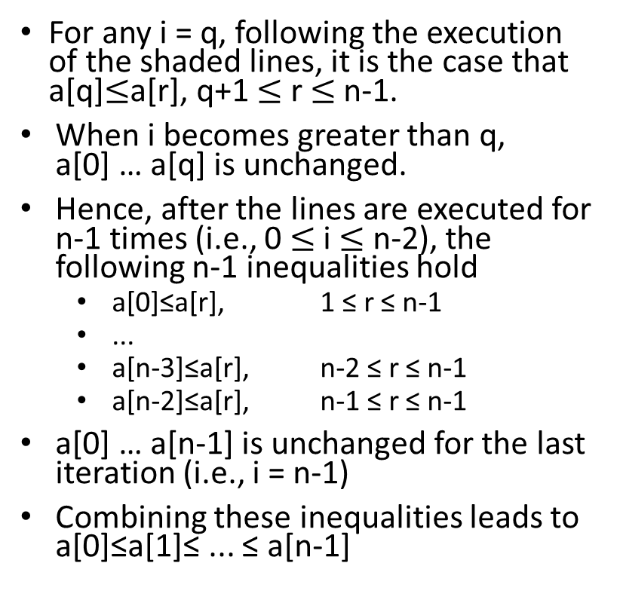
Selection Sort — Proof
For any i = q, following the execution of the shaded lines, it is the case that a[q]$≤$a[r], q+1 $≤$r$≤$n-1.
When i becomes greater than q, a[0] … a[q] is unchanged.
Hence, after the lines are executed for n-1 times (i.e., 0$≤$ i $≤$ n-2), the following n-1 inequalities hold
a[0]≤a[r], 1 ≤ r ≤ n-1
...
a[n-3]≤a[r], n-2 ≤ r ≤ n-1
a[n-2]≤a[r], n-1 ≤ r ≤ n-1
a[0] … a[n-1] is unchanged for the last iteration (i.e., i = n-1)
Combining these inequalities leads to a[0]≤a[1]≤ ... ≤ a[n-1]

Slide 74
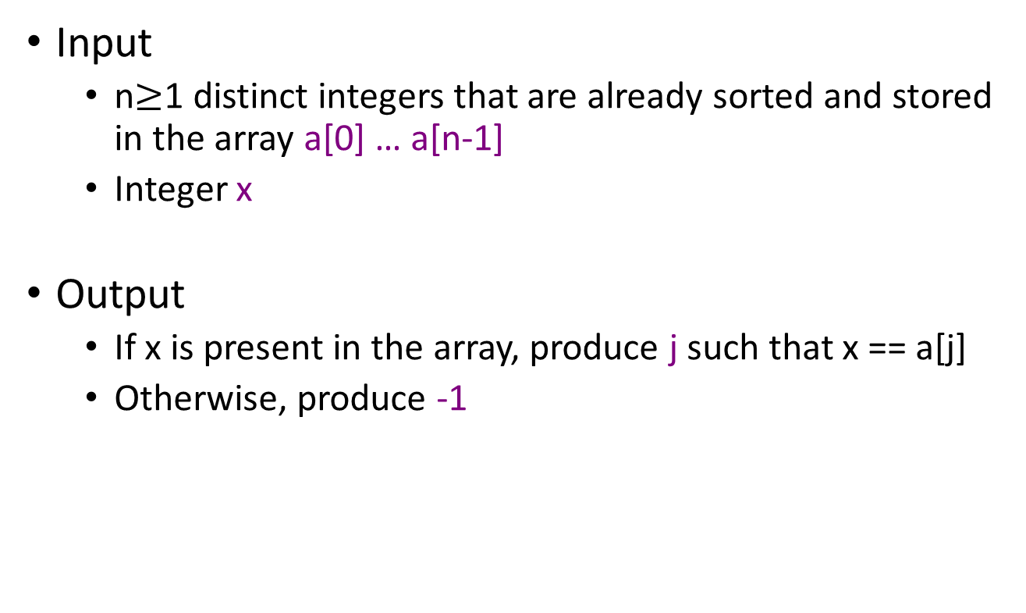
Binary Search
Input
n$≥$1 distinct integers that are already sorted and stored in the array a[0] … a[n-1]
Integer x
Output
If x is present in the array, produce j such that x == a[j]
Otherwise, produce-1

Slide 75
Binary Search — Pseudocode
int BinarySearch(int *a, const int x, const int n)
{ // Search the sorted array a[0], … , a[n-1] for x
// left and right are set to the two ends of a[]
Initialize left and right
while(there are elements between the two ends)
{
Let middle be the middle element index;
if(x < a[middle]) set right to middle-1;
else if(x > a[middle]) set left to middle+1;
else return middle;
}
Not found;
}

Slide 76
Binary Search — C++
int BinarySearch(int *a, const int x, const int n)
{ //Search the sorted array a[0]…a[n-1] for x
int left = 0, right = n-1;
while(left <= right)
{//there are more elements
int middle =(left+right)/2;
if(x < a[middle]) right=middle-1;
else if(x > a[middle]) left = middle+1;
else return middle; }//found
}//end of while
return -1; //not found
}

Slide 77
Correctness Proof
Make assertions about the relationship between variables before and after each iteration of the while loop
As entering this loop and if x is present in a, the following holds:
left≦right && a[left]≦x≦a[right] && SORTED(a,n)
If control passes out of the while loop, then left > right, which, combined with the above assertion, implies that x is not present in a

Slide 78
Binary Search ― Illustration
Search a number, 25, in a sorted array of boxes
37
20
30
24.9
Left
Right

Slide 79
Recursion
Definition
Functions that invoke themselves
Directly or Indirectly through other functions
Recursion is powerful
Divide and conquer
Method of induction (歸納法)
Can simplify the expression of an otherwise complex process

Slide 80
Recursion (Cont’d)
Recursion is particular useful for
Factorial (階乘)
Binomial coefficients
Binary search
Problems that are recursively defined
Recursion is not limited to the above tasks
Recursion can simulate looping (assignment,if-else, while) (Looping can simulate recursion, too)
Recursion tends to be (i.e., 有這個傾向，但不是絕對) slower than looping
Because function calls typically incur more latency than loop branches

Slide 81
Develop Recursion
Key components
Driver
Invoke the first workhorse
Workhorse(s)
Self-similar piece of the algorithm
Termination condition(s)
Determine whether no more progress needs be made
If a workhorse fails to check termination conditions, the program can never end
Make some progress
If nothing changes before the workhorse is again invoked, the program can never end
Driver()
{
workhorse();
}
once
many
workhorse()
{
if(termination conditions) {
return void or something;
} else {
Make some progress;
invoke child workhorse(s);
(Make more progress;)
}
}

Slide 82
Recursive Selection Sort
void SelectionSort(int a[], const int n)
{
// 1-entry array does not need sorting
if(n==1) return;
int j=0;
/* find the smallest in the received
array and place it at the first */
for(int k = 0; k<n; k++)
if(a[k] < a[j]) j = k;
swap(a[0], a[j]);
SelectionSort(a+1, n-1); //recursion
}
This is an exampling recursive algorithm derived from an non-recursive one. In this example, recursion is easier to understand but likely performs slower than its non-recursive counterpart.
Termination condition
Create a new workhorse to sort the remaining n-1 elements

Slide 83
Recursive Selection Sort
Sort 3 elements
SelectionSort(3)
termination?
return;
swap();
SelectionSort(2);
return;
SelectionSort(2)
termination?
return;
swap
SelectionSort(1);
return;
SelectionSort(1)
termination?
return;
swap
SelectionSort(1);
return;

Slide 84
Recursive Binary Search
int BinarySearch(int a[], const int x, const int left, const int right)
{
// no entries to search
if(left>right) return -1;
int middle = (left+right)/2;
if(x<a[middle]) return BinarySearch(a, x, left, middle-1);
else if(x>a[middle]) return BinarySearch(a, x, middle+1, right);
else return middle;
}
Termination condition
Create a new workhorse to search the half that possibly contain the target

Slide 85
Recursive Binary Search
int BinarySearch(int a[], const int x, const int left, const int right)
{
// search the sorted array a[left],..,a[right] for x
if(left<=right)
{
int middle = (left+right)/2;
if(x<a[middle]) return BinarySearch(a, x, left, middle-1);
else if(x>a[middle]) return BinarySearch(a, x, middle+1, right);
else return middle;
}//end of if
return -1;
}
Termination condition
Create a new workhorse to search the half that possibly contain the target

Slide 86
Permutation Generator
Given a set of n≧1 elements, the permutation problem is to generate all possible permutations of this set
For example, if the set is {a,b,c}, then the set of permutations is
{(a,b,c),(a,c,b),(b,a,c),(b,c,a),(c,a,b),(c,b,a)}
Given n elements, there are n! permutations.

Slide 87
Permutation Generator — Observation
Permutations of (a, b, c, d) can be constructed by
‘a’ followed by all permutations of (b, c, d)
‘b’ followed by all permutations of (a, c, d)
‘c’ followed by all permutations of (a, b, d)
‘d’ followed by all permutations of (a, b, c)
Clue to recursion
The expression “followed by all permutations “ is the clue to recursion
Solve an n-element problem based on the results of an (n-1)-element problem

Slide 88
Recursive Permutation Generator
void Permutations(int a[], const int k, const int m)
{
if(k == m) {
for(int i=0; i<=m; i++) cout << a[i] << " ";
cout << endl;
return;
}
for(int i=k; i<=m; i++) {
swap(a[k], a[i]); //enumerate all possible elements at a[k]
Permutations(a, k+1, m); // a workhorse to handle the rest
swap(a[k], a[i]); //restore the element
}
}
Termination condition
Note that in this algorithm, a workhorse can generate new workhorses multiple times
It is a bit hard (but still feasible) to transform this algorithm into an non-recursion version

Slide 89
Outline
1.1 Overview: System Life Cycle
1.2 Object-Oriented Design
1.3 Data Abstraction and Encapsulation
(1.4 Basics of C++)
1.5 Algorithm Specification
(1.6 Standard Template Library)
1.7 Performance Analysis and Measurement
Notes:
2017.2.18

Slide 90
Criteria for Judging a Program
Does it do what we want it to do?
Does it work correctly according to spec.?
Is there document that describes how to use it and how it work?
Are functions created in such a way that they perform logical subfunctions?
Is the code readable?
Space & time complexity

Slide 91
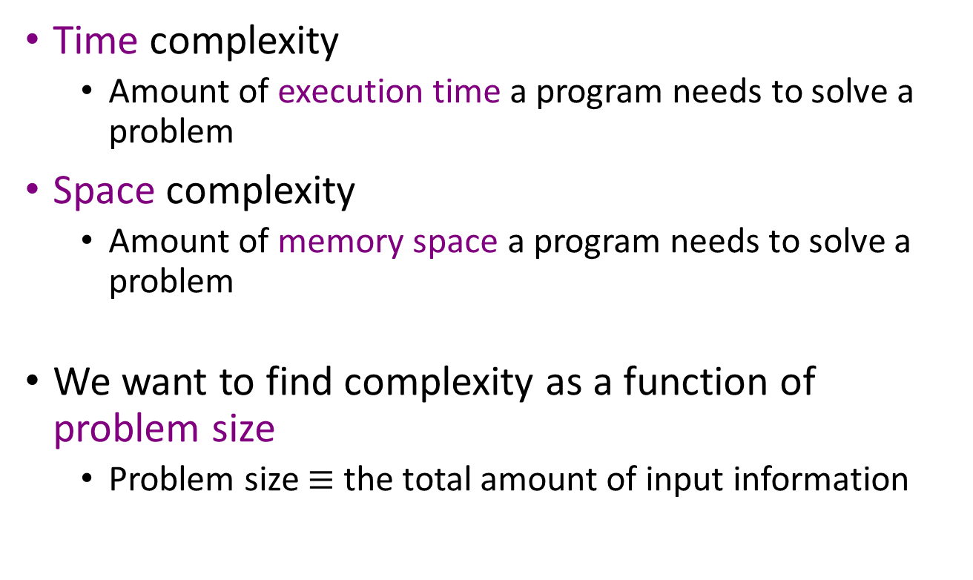
Complexity
Time complexity
Amount of execution time a program needs to solve a problem
Space complexity
Amount of memory space a program needs to solve a problem
We want to find complexity as a function of problem size
Problem size $≡$ the total amount of input information

Slide 92
Space Complexity
S(P) = c + S_{p}(instance characteristics)
Breakdown
Problem size-dependent part (S_{p}(instance characteristics))
Variables whose size/number depends on problem size
Fixed part (c)
Space for storing the program
Fixed amount of variables during computation
Read-only space for Inputs
Write-only space for outputs
We shall focus on the problem size-dependent part

Slide 93
Space Complexity (Cont’d)
float abc (float a, float b, float c)
{
float y;
y = a+b+b*c+(a+b-c)/(a+b);
return y;
}
a, b, and c are read-only inputs
A fixed amount of space is required to do the computation
→ Problem size-dependent part is 0
float sum (float *a, const int n)
{
float s = 0;
for (int i = 0; i < n; i++)
s += a[i];
return s;
}
a[0]…a[n-1] are read-only inputs
Float * a, const int n, float s, int i, etc. consume a fixed amount of space
→ Problem size-dependent part is 0

Slide 94
Space Complexity
a[0]…a[n-1] are read-only inputs
float * a and int n (and other variables local to Rsum()) consume a fixed amount of space for each execution of Rsum though, Rsum is called n+1 times.
Space complexity = c(n+1), where c is a constant, say c=4
float Rsum (float *a, const int n)
{
if (n <= 0)
return 0;
else
return (Rsum(a, n-1) + a[n-1]);
}
Inputs
Rsum(a, 90){
…
Rsum(a,89);
}
a[0]…a[n-1]
Rsum(a, 89){
…
Rsum(a,88);
}
Rsum(a, 0){
…
}
……
output
Return value
Return address
a
n
..
..
a
n
..
..
a
n
..
..
Variables whose number depends on the problem size

Slide 95
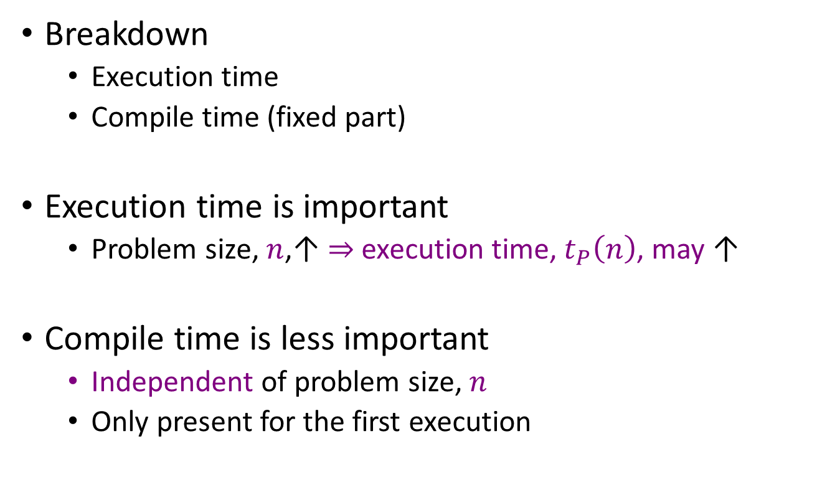
Time Complexity
T(P) = t_{compile} + t_{p}(n)
Breakdown
Execution time
Compile time (fixed part)
Execution time is important
Problem size, $n$,↑ $⇒$execution time, $t_{P}\left(n\right)$, may↑
Compile time is less important
Independent of problem size, $n$
Only present for the first execution

Slide 96
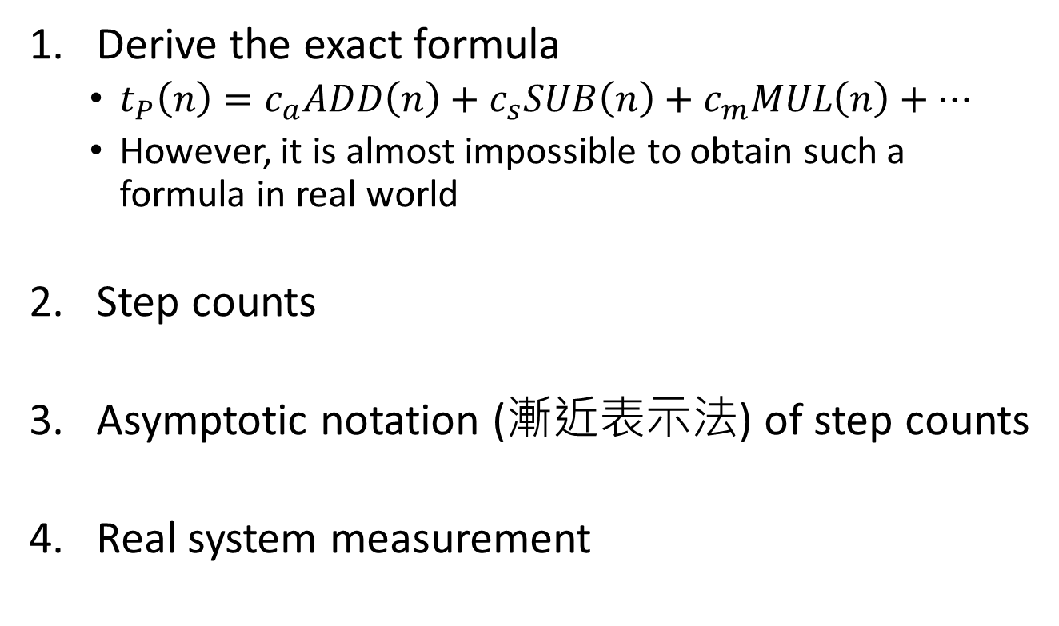
Methods to Derive Execution Time
Derive the exact formula
$t_{P}\left(n\right)=c_{a}ADD\left(n\right)+c_{s}SUB\left(n\right)+c_{m}MUL\left(n\right)+…$
However, it is almost impossible to obtain such a formula in real world
Step counts
Asymptoticnotation (漸近表示法) of step counts
Real system measurement

Slide 97
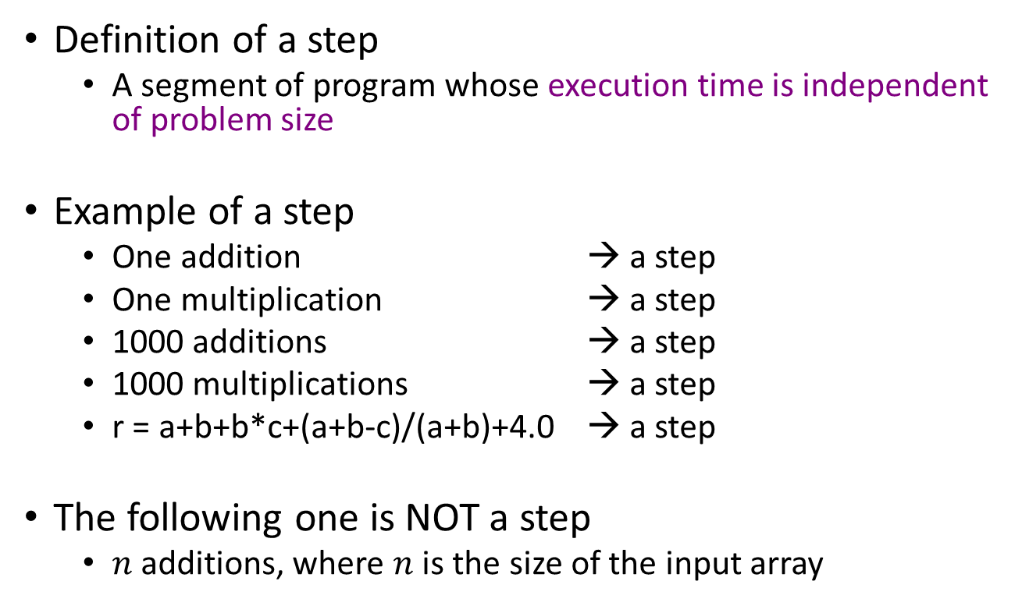
Step Count
Definition of a step
A segment of program whose execution time is independent of problem size
Example of a step
One addition → a step
One multiplication → a step
1000 additions → a step
1000 multiplications → a step
r = a+b+b*c+(a+b-c)/(a+b)+4.0 → a step
The following one is NOT a step
$n$ additions, where $n$ is the size of the input array

Slide 98
Zero-Step Program Segments
Comments
// this is binary search
/* this is * selection sort */
Declarative statements of variables and functions
int a;
float b, c, d;
int max(a, b);
Brackets, line labels, and the else keyword
{
}
} else {
END:

Slide 99
Single-Step Program Segments
Assignment statements and expressions
int a = 10;
b = 0.1;
c = a + b * d; //expression with no function call
Looping statements (single-step per loop iteration)
for(int i=0; i<n; i+=3)
while(j<n²)
do … while(n>10)
Functions that independent of problem size
a = max(b, c)
Conditional statements
if(a > 10)
Unconditional branches
goto, break, continue, return

Slide 100
Those May Depend on Problem Size
Object/variable construction
int *a = new int[size(input)];
Function execution
MatrixAdd(a, b, c); // adding two matrixes
Parameter passing (pass by value)
Passing an object whose size depends on problem size
Statements that involve the above events
int b = sum(a, n);
if(search(a, x, n) == true)

Slide 101
Methods of Obtaining Step Count
Instrumentation (實際測量)
Introduce a new global variable: count
Initialize count to zero
Add statements to increment count for each step
Report count
Table analysis (紙筆分析)
List the step count of each program segment
List the frequency of each program segment
Summarize the total step count

Slide 102
Step Counting — Example 1
float sum (float *a, const int n)
{
float s = 0;
for (int i = 0; i < n; i++)
s += a[i];
return s;
}

Slide 103
Step Counting Using Instrumentation
float sum (float *a, const int n)
{
float s = 0;
count++; // count is global
for (int i = 0; i < n; i++) {
count++; // for loop
s += a[i];
count++; // assignment
}
count++; // last time of for
count++; // return
return s;
}
Simplified version
void sum (float *a, const int n)
{
for (int i = 0; i < n; i++) {
count+=2;
}
count+=3;
return;
}
Total steps = 2n + 3

Slide 104
Step Counting Using a Table
float sum (float *a, const int n) s/e freq. subtotal
{ 0
float s = 0; 1 1 1
for (int i = 0; i < n; i++) 1 n+1 n+1
s += a[i]; 1 n n
return s; 1 1 1
} 0
total: 2n+3
s/e: steps per execution
The frequency of executing the control statement is one time more than that of the loop body.

Slide 105
Step Counting — Example 2
float Rsum (float *a, const int n)
{
if (n <= 0)
return 0;
else
return (Rsum(a, n-1) + a[n-1]);
}
Recursion

Slide 106
Step Counting — Instrumentation
float Rsum (float *a, const int n)
{
count++; // if conditional
if (n <= 0) {
count++; // return statement
return 0;
} else {
count++; // return statement
return (Rsum(a, n-1) + a[n-1]);
}
}
count is a global variable and will be incremented throughout the entire recurrent computation.

Slide 107
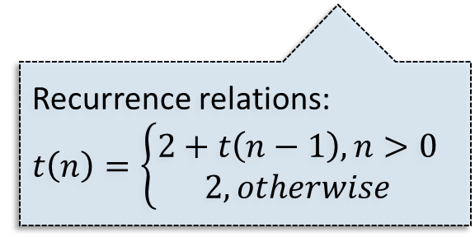
Step Counting — Table
freq. subtotal
float Rsum (float *a, const int n) s/e n=0 n>0 n=0 n>0
{ 0
if (n <= 0) 1 1 1 1 1
return 0; 1 1 0 1 0
else 0
return (Rsum(a, n-1) + a[n-1]); 1+t(n-1) 0 1 0 1+t(n-1)
} 0
total 2 2+t(n-1)
s/e: steps per execution
Recurrence relations:
$$t\left(n\right)=\left\{\begin{matrix}2+t\left(n−1\right), n>0 \\ 2, otherwise\end{matrix}\right.$$

Slide 108
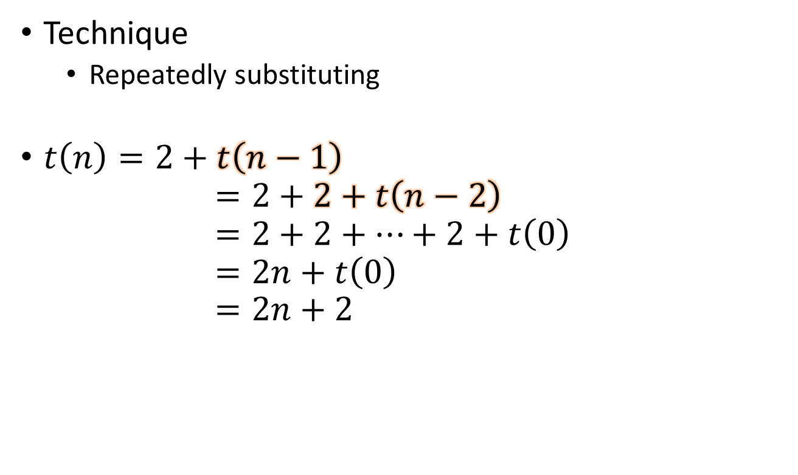
Solving Recurrence
Technique
Repeatedly substituting
$t\left(n\right)=2+t\left(n−1\right)$ $=2+2+t\left(n−2\right)$ $=2+2+…+2+t\left(0\right)$ $=2n+t\left(0\right)$ $=2n+2$

Slide 109
Step Counting — Example 3
void MatAdd (int **a, int **b, int **c, int m, int n)
{
for (int i = 0; i < m; i++) {
for (int j = 0; j < n; j++) {
c[i][j] = a[i][j] + b[i][j];
}
}
return;
}
Program containing nested loops

Slide 110
Step Counting — Instrumentation
void MatAdd (int **a, int **b, int **c, int m, int n)
{
for (int i = 0; i < m; i++) {
count++; // for loop i
for (int j = 0; j < n; j++) {
count++; // for loop j
c[i][j] = a[i][j] + b[i][j];
count++; // assignment
}
count++; // last time of the for loop j
}
count++; // last time of the for loop i
count++; // return statement
return;
}
The textbook omits the return

Slide 111
Step Counting — Simplified
void MatAdd (int **a, int **b, int **c, int m, int n)
{
for (int i = 0; i < m; i++) {
for (int j = 0; j < n; j++) {
count += 2;
}
count += 2;
}
count += 2; //last time of the for loop i & return statement
}
Total step count = m(2n+2) + 2 = 2mn + 2m + 2
If m > n, better to interchange the two for statements:
Total step count = n(2m+2) + 2 = 2mn + 2n + 2

Slide 112
Step Counting — Table
void MatAdd (int **a, int **b, int **c, int m, int n)
s/e freq. subtotal
{ 0
for (int i = 0; i < m; i++) 1 m+1 m+1
for (int j = 0; j < n; j++) 1 m(n+1) mn+m
c[i][j] = a[i][j] + b[i][j]; 1 mn mn
return; 1 1 1
} 0
total: 2mn+2m+2
The textbook omits the return
We are allowed to use more than one variables to describe problem size

Slide 113
Step Counting — Example 4
void fibonacci (int n) //compute the Fibonacci number F[n]
{
if (n <= 1)
cout << n << endl; // F[0] = 0 and F[1] = 1
else { // compute F[n]
int fn; int fnm2 = 0; int fnm1 = 1;
for (int i = 2; i<=n; i++) {
fn = fnm1 + fnm2;
fnm2 = fnm1;
fnm1 = fn;
} // end of for
cout << fn << endl;
} // end of else
return;
} // end of fibonacci
// steps = 1
// steps = 1
// steps = 2
// steps = n
// steps = 3(n-1)
// steps = 1
// steps = 1
If n > 1,
t(n) = 1 + 2 + n + 3(n-1) + 1 + 1 = 4n+1
Otherwise, t(n) = 1+1+1 = 3

Slide 114
3 Kinds of Step Counts
Time complexity is not dependent solely on the number of inputs or outputs
Consider BinarySearch(a,x,n). For the same n, the step count varies with the position of x in a
Best-case step count
The minimum # of steps that can be executed
Worst-case step count
The maximum # of steps that can be executed
Average-case step count
The average # of steps that can be executed

Slide 115
Inexactness of Step Count
We cannot know which following step count number represents the shortest execution time, where n stands for the problem size
Step(Alg1) = n+1
Step(Alg2) = n+1000
Step(Alg3) = 1000n
Step(Alg4) = 1000n+1000
But we know the execution time of these programs linearly increases with problem size
Since the notion of a step is (deliberately) imprecise.
1 step can be 1 multiplication or multiple multiplications

Slide 116
Motivation of Asymptotic Notation
We also know the fifth algorithm exhibits the shortest execution time once the problem size, n, is large enough
Step(Alg1) = n+1
Step(Alg2) = n+1000
Step(Alg3) = 1000n
Step(Alg4) = 1000n+1000
Step(Alg5) = log₂(n)+1000
Asymptotic Notations are introduced to describe/emphasize
Trend that an algorithm's step count increases with problem size
Classification of problems/algorithms based on the trend
Linearly increase
Logarithmically increase

Slide 117
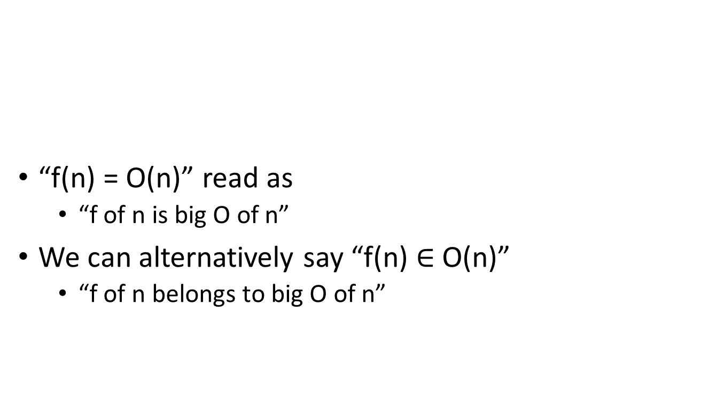
Asymptotic Notations (O, Ω, Θ)
“f(n) = O(n)” read as
“f of n is big O of n”
We can alternatively say “f(n) $∈$ O(n)”
“f of n belongs to big O of n”
O | Big O | Upper bound
Θ | Theta | Tight bound
Ω | Omega | Lower bound

Slide 118
Asymptotic Notations (O)
Definition [Big “oh”]
f(n) = O(g(n)) (read as f of n is big oh of g of n) iff (if and only if) there exist positive constants c and n₀ such that f(n) ≦ cg(n) for all n ≧ n₀.
f(n) = 3n+2 = O(n) (3n+2 ≦ 4n for n ≧ 2)
f(n) = 100n+2 = O(n) (100n+2 ≦ 101n for n ≧ 2)
f(n) = 3n²+4n+2 = O(n²) (3n²+4n-4 ≦ 4n² for n ≧ 2)
f(n) = 6*2^{n}+n² = O(2^{n}) (6*2^{n}+n² ≦ 7*2^{n} for n ≧ 4)

Slide 119
Examples of Asymptotic Notations
Upper-bound (O) descriptions of the time complexity (i.e., in step counts)
Alg1 : n+1 = O(n)
Alg2 : n+1000 = O(n)
Alg3 : 1000n = O(n)
Alg4 : 1000n+1000 = O(n)
Alg5 : log₂(n)+1 = O(n)
Meanings
Their time complexity is no more than n
n denotes the problem size and we focus on large problem size for asymptotic notations

Slide 120
Examples of Asymptotic Notations
Following upper-bound statements are both true
Alg5 : log₂(n)+1 = O(n)
Alg5 : log₂(n)+1 = O(log₂(n))
Meanings
The time complexity of Alg5 is no more than log(n)

Slide 121
Asymptotic Notations (Θ)
Definition [Theta] (tight bound)
f(n) = Θ(g(n)) (read as f of n is theta of g of n) iff (if and only if) there exist positive constants c₁, c₂, and n₀ such that c₁g(n) ≦ f(n) ≦ c₂g(n) for all n ≧ n₀.
f(n) = 3n+2 = Θ(n) (3n≦3n+2≦4n for n ≧ 2)
f(n) = 10n²+4n+2 = Θ(n²) (10n² ≦ 10n²+4n+2≦11n² for n ≧ 2)
f(n) = 6*2^{n}+n² = Θ(2^{n})
3n+2 ≠ Θ(1), 6*2^{n}+n² ≠ Θ(n²), 6*2^{n}+n² ≠ Θ(n¹⁰⁰)

Slide 122
Examples of Asymptotic Notations
Tight-bound (Θ) descriptions
Alg1 : n+1 = Θ(n)
Alg2 : n+1000 = Θ(n)
Alg3 : 1000n = Θ(n)
Alg4 : 1000n+1000 = Θ(n)
Alg5 : log₂(n)+1 = Θ(log₂(n))
Meanings
The time complexity of Alg1~4 is equal to n
The time complexity of Alg5 is equal to log(n)

Slide 123
Asymptotic Notations (Ω)
Definition [Omega] (lower bound)
f(n) = Ω(g(n)) (read as f of n is omega of g of n) iff (if and only if) there exist positive constants c and n₀ such that f(n) ≧ cg(n) for all n ≧ n₀.
f(n) = 3n+2 = Ω(n) (3n+2 ≧ 3n for n ≧ 2)
f(n) = 100n+2 = Ω(n) (100n+2 ≧ 100n for n ≧ 1)
f(n) = 3n²+4n+2 = Ω(n²) (3n²+4n-4 ≧ n² for n ≧ 1)
f(n) = 6*2^{n}+n² = Ω(2^{n}) (6*2^{n}+n² ≧ 2^{n} for n ≧ 1)

Slide 124
Examples of Asymptotic Notations
Lower-bound (Ω) descriptions
Alg1 : n+1 = Ω(n)
Alg2 : n+1000 = Ω(n)
Alg3 : 1000n = Ω(n)
Alg4 : 1000n+1000 = Ω(n)
Alg5 : log₂(n)+1 = Ω(log₂(n))
Meanings
The time complexity of Alg1~4 is no less than n
The time complexity of Alg5 is no less than log(n)

Slide 125
Examples of Asymptotic Notations
These lower-bound (Ω) descriptions are true of course
Alg1 : n+1 = Ω(log₂(n))
Alg2 : n+1000 = Ω(log₂(n))
Alg3 : 1000n = Ω(log₂(n))
Alg4 : 1000n+1000 = Ω(log₂(n))
Meanings
The time complexity of Alg1~4 is no less than log(n)

Slide 126
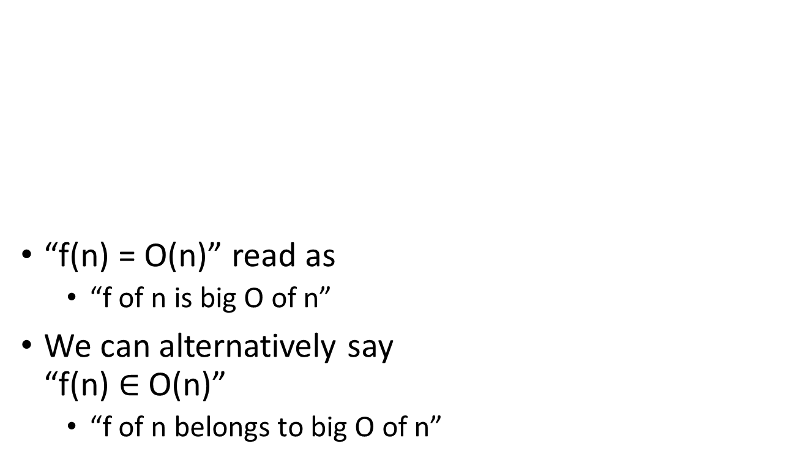
Asymptotic Notations (O, Ω, Θ)
“f(n) = O(n)” read as
“f of n is big O of n”
We can alternatively say “f(n) $∈$ O(n)”
“f of n belongs to big O of n”
O | Big O | Upper bound
Θ | Theta | Tight bound (i.e., both an upper bound and lower bound )
Ω | Omega | Lower bound
“Big” O → Upper
“Θ” → A hyphen in the middle → tight bound

Slide 127

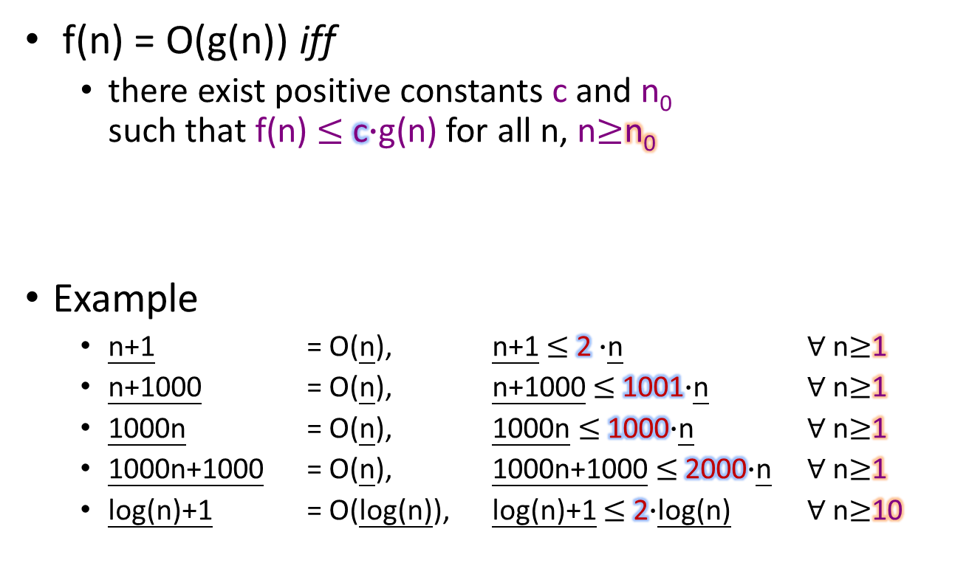
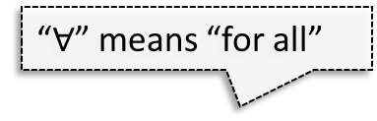
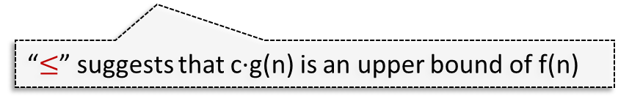
Big O Definitions
“iff” means “if and only if” (“$⟺$”)
f(n) = O(g(n)) iff
there exist positive constants c and n₀ such that f(n) $≤$c$∙$g(n) for all n, n$≥$n₀
Example
n+1= O(n),n+1$≤$ 2$∙$n$∀$ n$≥$1
n+1000 = O(n), n+1000$≤$ 1001$∙$n$∀$n$≥$1
1000n = O(n), 1000n$≤$ 1000$∙$n$∀$n$≥$1
1000n+1000 = O(n), 1000n+1000$≤$2000$∙$n$∀$ n$≥$1
log(n)+1 = O(log(n)),log(n)+1$≤$2$∙$log(n)$∀$ n$≥$10
“$≤$” suggests that c∙g(n) is an upper bound of f(n)
“$∀$” means “for all”

Slide 128
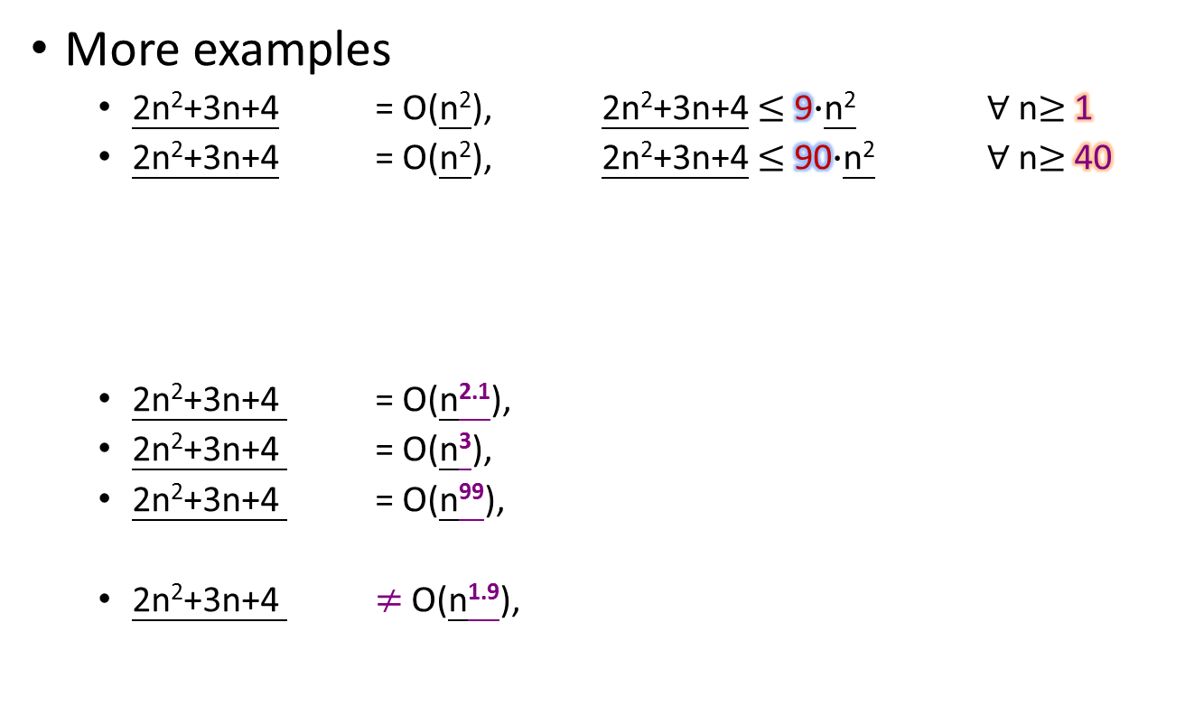
Big O Definitions (Cont’d)
More examples
2n²+3n+4 = O(n²),2n²+3n+4$≤$9$∙$n²$∀$ n$≥$1
2n²+3n+4 = O(n²),2n²+3n+4$≤$90$∙$n²$∀$ n$≥$40
2n²+3n+4 = O(n^{2.1}),
2n²+3n+4 = O(n³),
2n²+3n+4 = O(n⁹⁹),
2n²+3n+4 $≠$O(n^{1.9}),
We may have an infinite number of c and n0 satisfying the inequality.
Since by definition, Big O does not need to be a tight bound, we may have infinite number of g(n) satisfying the inequality.

Slide 129
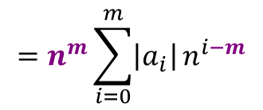
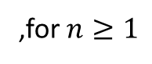
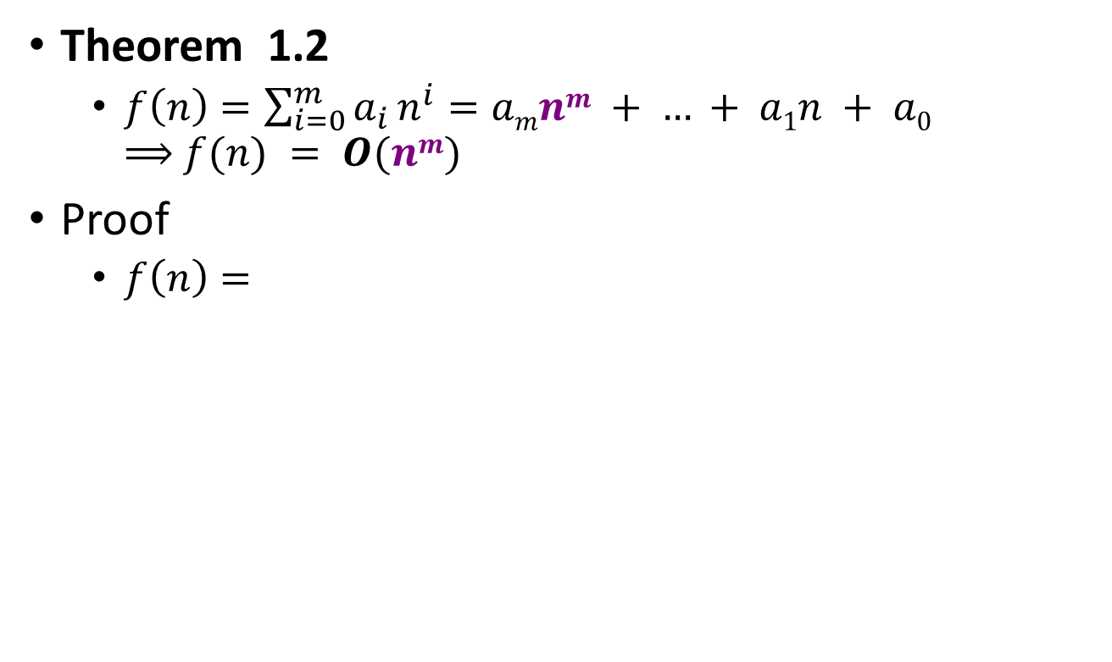
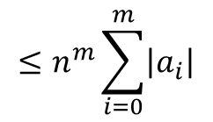
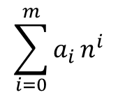
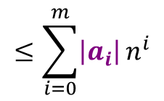
Big O of a Polynomial Function
Theorem 1.2
$f\left(n\right)=\sum_{i=0}^{m}{a_{i}}n^{i}=amnm + … + a1n + a0$ $⟹$$f(n) = O(nm)$
Proof
$f\left(n\right)=$
$$\sum_{i=0}^{m}{a_{i}}n^{i}$$
$$≤\sum_{i=0}^{m}{\left|a_{i}\right|}n^{i}$$
$$=n^{m}\sum_{i=0}^{m}{\left|a_{i}\right|}n^{i−m}$$
$$≤n^{m}\sum_{i=0}^{m}{\left|a_{i}\right|}$$
,for $n≥1$

Slide 130
Common Big O Hierarchy
n!
exp.
cubic
O(n!) factorial
O(2^{n}) exponential
O(n^{k})
…
O(n³) cubic
O(n²) quadratic
O(nlog(n)) log-linear
O(n) linear
O(n^{0.x}) sub-linear
O(log(n)) logarithm
O(1) constant
quadratic
…
const.
O(n²) algorithms/problems are also O(n³) ones, and so on
Many other classes are not listed here, e.g., O(n^{1.5}), O(loglog(n)), O(nlog²(n))…
O(1) means that the execution time is independent of problem size
E.g., time for retrieving the k^{th} entry of an array (of size n) is O(1)

Slide 131
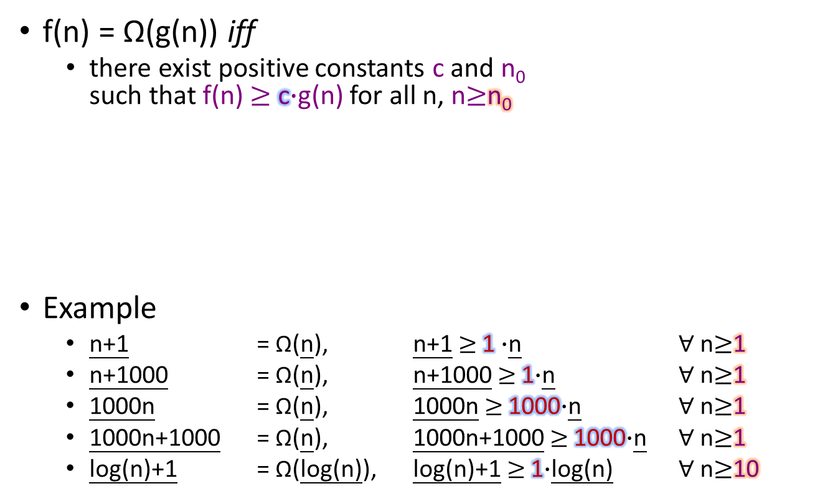
Omega Definitions
f(n) = Ω(g(n)) iff
there exist positive constants c and n₀ such that f(n) $≥$c$∙$g(n) for all n, n$≥$n₀
Example
n+1 = Ω(n),n+1$≥$1$∙$n$∀$ n$≥$1
n+1000 = Ω(n), n+1000$≥$1$∙$n$∀$ n$≥$1
1000n = Ω(n), 1000n$≥$1000$∙$n$∀$ n$≥$1
1000n+1000 = Ω(n), 1000n+1000$≥$1000$∙$n$∀$ n$≥$1
log(n)+1 = Ω(log(n)),log(n)+1$≥$1$∙$log(n)$∀$ n$≥$10
Compare with Big O
such that f(n) ≦ cg(n) for all n ≧ n₀.

Slide 132
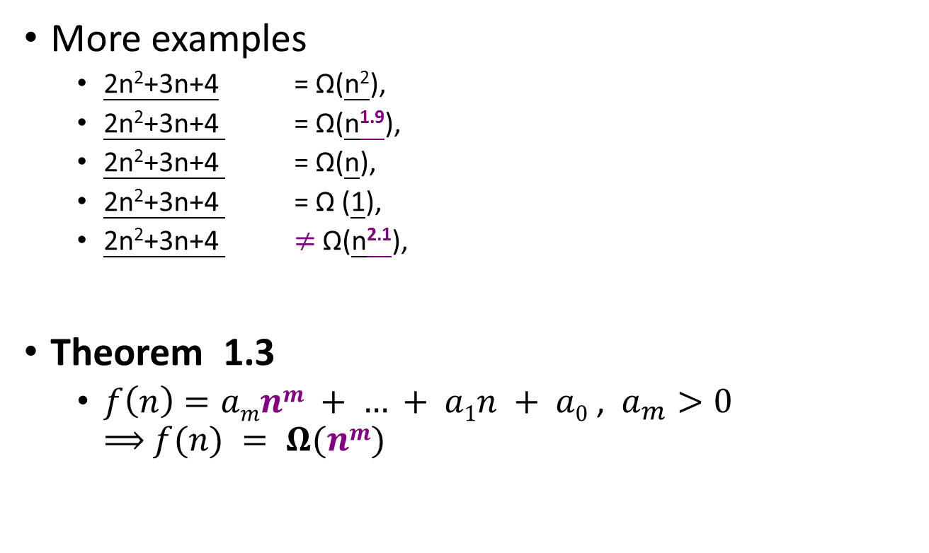
Omega Definitions (Cont’d)
More examples
2n²+3n+4 = Ω(n²),
2n²+3n+4 = Ω(n^{1.9}),
2n²+3n+4 = Ω(n),
2n²+3n+4 = Ω (1),
2n²+3n+4 $≠$Ω(n^{2.1}),
Theorem 1.3
$f\left(n\right)=amnm + … + a1n + a0$ , $a_{m}>0$ $⟹$$f(n) = Ω(nm)$

Slide 133
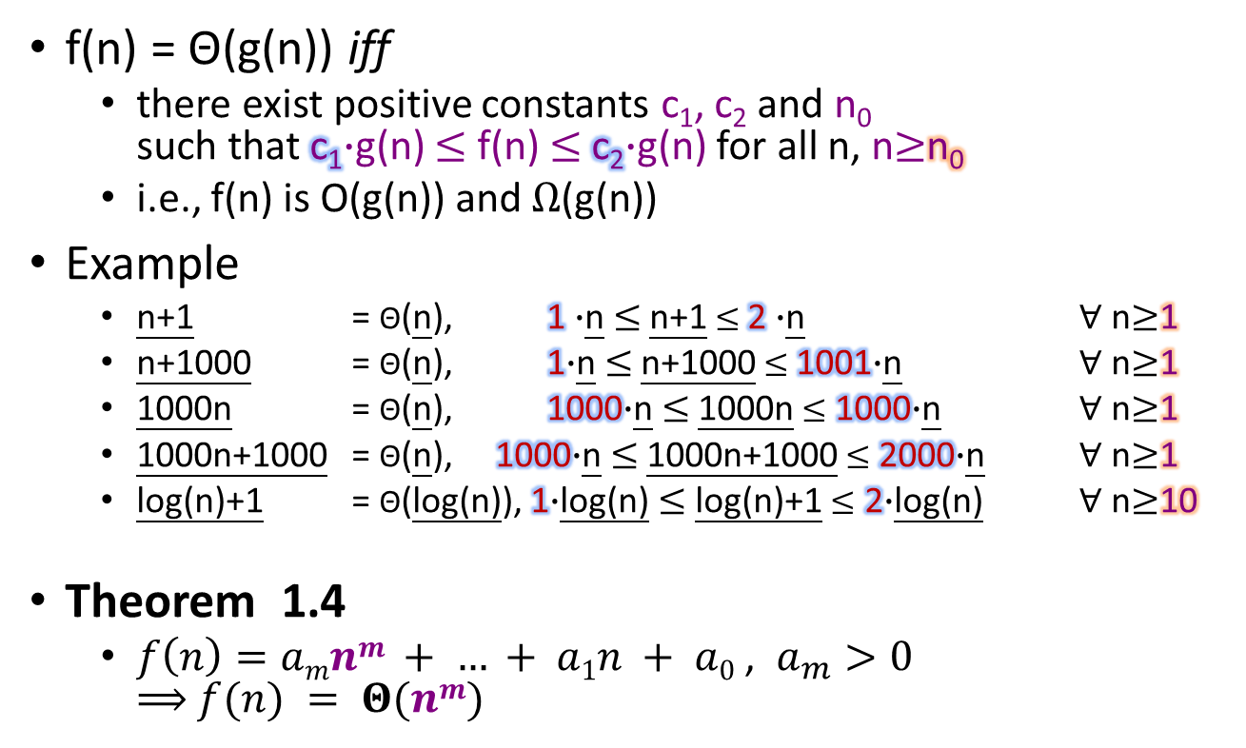
Theta Definitions
f(n) = Θ(g(n)) iff
there exist positive constants c₁, c₂and n₀ such that c₁$∙$g(n) $≤$f(n) $≤$c₂$∙$g(n) for all n, n$≥$n₀
i.e., f(n) is O(g(n)) and $Ω$(g(n))
Example
n+1 = Θ(n),1$∙$n$≤$n+1$≤$2$∙$n$∀$ n$≥$1
n+1000 = Θ(n), 1$∙$n$≤$n+1000$≤$1001$∙$n$∀$ n$≥$1
1000n = Θ(n), 1000$∙$n$≤$1000n$≤$1000$∙$n$∀$ n$≥$1
1000n+1000 = Θ(n), 1000$∙$n$≤$1000n+1000$≤$ 2000$∙$n$∀$ n$≥$1
log(n)+1 = Θ(log(n)),1$∙$log(n)$≤$log(n)+1$≤$ 2$∙$log(n)$∀$ n$≥$10
Theorem 1.4
$f\left(n\right)=amnm + … + a1n + a0$ , $a_{m}>0$ $⟹$$f(n) = Θ(nm)$

Slide 134
Step Counting — Asymptotic Notation
float sum (float *a, const int n) s/e freq. subtotal
{ 0
float s = 0; 1 Θ(1) Θ(1)
for (int i = 0; i < n; i++) 1 Θ(n) Θ(n)
s += a[i]; 1 Θ(n) Θ(n)
return s; 1 Θ(1) Θ(1)
} 0
overall: Θ(n)
s/e: number of steps per execution

Slide 135
Step Counting — Asymptotic Notation
(recursion of sum()) freq. subtotal
float Rsum (float *a, const int n) s/e n=0 n>0 n=0 n>0
{ 0
if (n <= 0) 1 Θ(1) Θ(1) Θ(1) Θ(1)
return 0; 1 Θ(1) 0 Θ(1) 0
else 0
return (Rsum(a, n-1) + a[n-1]); 1+t(n-1) 0 Θ(1) 0 Θ(1+t(n-1))
} 0
overall: Θ(1) Θ(1+t(n-1))
s/e: number of steps per execution

Slide 136
Step Counting — Asymptotic Notation
void MatAdd (int **a, int **b, int **c, int m, int n)
{
for (int i = 0; i < m; i++) Θ(m)
for (int j = 0; j < n; j++) Θ(mn)
c[i][j] = a[i][j] + b[i][j];
return;
}
overall: Θ(mn)

Slide 137
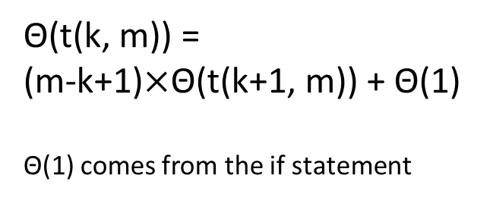
Recursive Permutation Generator
void Permutations(int *a, const int k, const int m)
{
// one element between k and m means one possible permutation
if(k == m) {
for(int i=0; i<=m; i++)
cout << a[i] << " ";
cout << endl;
return;
}
for(int i=k; i<=m; i++) {
swap(a[k], a[i]);
Permutations(a, k+1, m);
swap(a[k], a[i]);
}
}
k==m → Θ(t(k, m)) = Θ(m)
Θ(t(k, m)) = (m-k+1)$×$Θ(t(k+1, m)) + Θ(1)
Θ(1) comes from the if statement

Slide 138
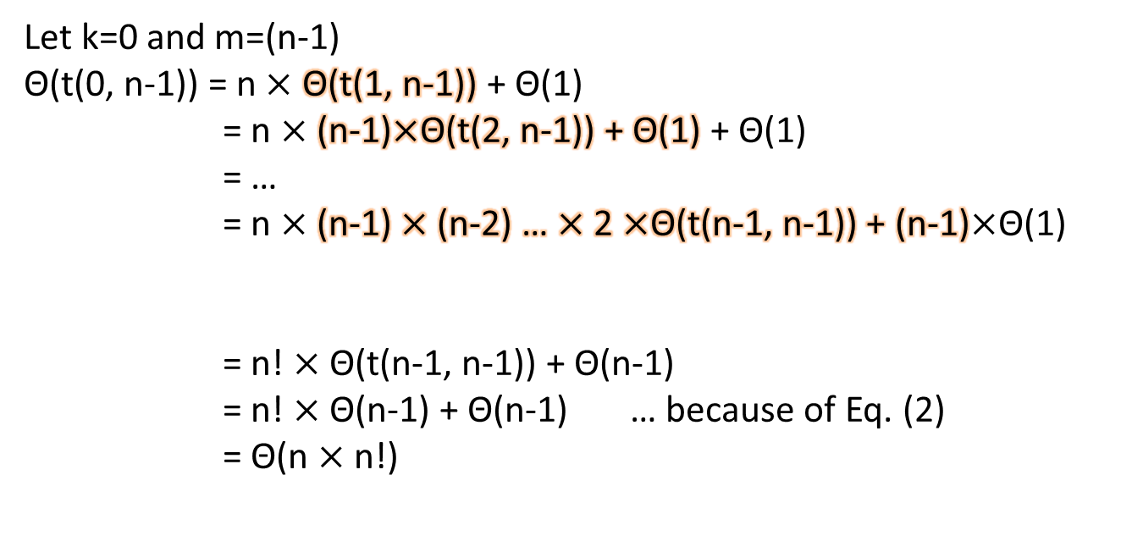
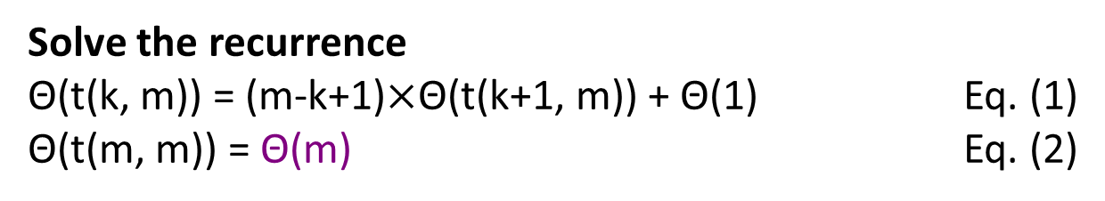
Recursive Permutation Generator
Solve the recurrence
Θ(t(k, m)) = (m-k+1)$×$Θ(t(k+1, m)) + Θ(1) Eq. (1)
Θ(t(m, m)) = Θ(m) Eq. (2)
Let k=0 and m=(n-1)
Θ(t(0, n-1)) = n $×$Θ(t(1, n-1))+ Θ(1)
= n $×$(n-1)$×$Θ(t(2, n-1)) + Θ(1) + Θ(1)
= …
= n $×$(n-1)$×$ (n-2) … $×$ 2 $×$Θ(t(n-1, n-1)) + (n-1)$×$Θ(1)
= n! $×$Θ(t(n-1, n-1)) + Θ(n-1)
= n! $×$Θ(n-1) + Θ(n-1) … because of Eq. (2)
= Θ(n$×$n!)
n-1 equations
n-1 terms

Slide 139
Binary Search
int BinarySearch(int *a, const int x, const int n)
{ //Search the sorted array a[0], … , a[n-1] for x
int left = 0, right = n-1;
while(left <= right)
{//there are more elements
int middle =(left+right)/2;
if(x<a[middle]) right=middle-1;
else if(x>a[middle]) left = middle+1;
else return middle;
}//end of while
return -1;
}
Θ(log(n))

Slide 140
Magic Square
= 65
15 | 8 | 1 | 24 | 17
16 | 14 | 7 | 5 | 23
22 | 20 | 13 | 6 | 4
3 | 21 | 19 | 12 | 10
9 | 2 | 25 | 18 | 11
= 65
= 65
= 65
= 65
= 65
= 65
= 65
= 65
= 65
= 65
= 65

Slide 141
H. Coxeter Rule for Magic Square
To generate a magic square of n x n when n is odd:
Start with 1 in the middle of the top row; then go up and left, assigning numbers in increasing order to empty squares;
If you fall off the square imagine the same square as tiling the plane and continue;
If a square is occupied, move down instead and continue.

Slide 142
Magic Square Underlying Concept
15 | 8 | 1 | 24 | 17
16 | 14 | 7 | 5 | 23
22 | 20 | 13 | 6 | 4
3 | 21 | 19 | 12 | 10
9 | 2 | 25 | 18 | 11

Slide 143
Magic Square Algorithm
void magic (int n)
// create a magic square of size n, n is odd
{
const int MaxSize = 51; // maximum square size
int square[MaxSize][MaxSize], k, l;
// check correctness of n
if ((n > MaxSize) || (n < 1)) {
cerr << "Error!..n out of range \n";
eturn;
}else if (!(n%2)) {
cerr << "Error!..n is even \n";
return;
}
// n is odd. Coxeter's rule can be used
for (int i = 0; i < n; i++) // initialize square to 0
for (int j = 0; j < n; j++)
square[i][j] = 0;
square[0][(n-1)/2] = 1; // middle of first row
// please continue to the next slide…
Θ(1)
Θ(1)
Θ(n²)
Θ(1)

Slide 144
// i and j are current position
int key = 2; i = 0;
int j = (n-1)/2;
while (key <= n*n) {
// move up and left
if (i-1 < 0) k = n-1; else k = i-1;
if (j-1 < 0) l = n-1; else l = j-1;
if (square[k][l]) i = (i+1)%n;
else { // square[k][l] is unoccupied
i = k;
j = l;
}
square[i][j] = key;
key++;
} // end of while
// output the magic square
cout << "magic square of size " << n << endl;
for ( i = 0; i < n; i++) {
for ( j = 0; j < n; j++)
cout << square[i][j] << " ";
cout << endl;
}
}
Θ(1)
Θ(n²)
Θ(1)
Θ(n²)

Slide 145
Magic Square (Cont’d)
We just show how can we quickly analyze the complexity of an algorithm without knowing all the details
Θ(n²) is the optimal one we can achieve (in terms of asymptotic complexity) to generate an n² magic square
Since there are n² positions the algorithm must place a number

Slide 146
Practical Complexities
Prob. size | n | nlog(n) | n² | n³ | n⁴ | 2^{n}
100 | .1 μs | .66 μs | 10 μs | 1 ms | 100 ms | 4 x 10¹³ y
10³ | 1 μs | 10 μs | 1 ms | 1 s | 17 min | 3.2 x 10²⁸³ y
10⁴ | 10 μs | 130 μs | 100 ms | 17 m | 116 d
10⁵ | 0.1 ms | 1.7 ms | 10 s | 12 d | 3171 y
10⁶ | 1 ms | 20 ms | 17 m | 32 y | 3 x 10⁷ y
Assume a computer that performs 1 billion steps per second

Slide 147
Practice Complexity
2^{n}
n²
t(n)
nlog₂n
n
log₂n
n

Slide 148
Limitations of asymptotic analysis
For two programs that are both O(n²) time complexity
We cannot tell which is faster because we doesn’t account for constant factors
For one program that is O(n) and the other is O(n²)
Sometimes the problem size is not very large, and the O(n²) one actually is faster than the O(n) one
E.g., 1000n vs n² and interested in n < 1000
Modern computers have a hierarchical memory organization with different access time for memory at different levels of the hierarchy.
Our analysis doesn’t account for this difference in memory access times. So programs that do more work may take less time than those that do less work

Slide 149
Memory Hierarchy
MAIN
L2
L1
ALU
R
8-32
32KB
512KB
512MB
1C
2C
10C
100C

Slide 150
Performance Measurement
Performance measurement provide actual execution time. It depends on:
Particular compiler & options
Specific computer
Measure actual time on an actual computer, we need
programming language
working program
Computer
compiler and options to use
data to use for measurement
timing mechanism --- clock

Slide 151
Performance Measurement
Techniques
Use time-related library functions
gettimeofday()
clock()
time()
Repeatedly measure a program to reduce noises
Use randomized inputs to obtain best-case, average, and worst-case execution time
Predict the execution time of a problem with different input size
Regression (curve fitting)
Interpolation
Extrapolation
Please read Section 1.7.2 for details

Slide 152
Timing In C++
long start, stop;
time(start); // set start to current time in
// hundredths of a second
// code to be timed comes here
time(stop); // set stop to current time
long runTime = stop – start;

Slide 153
Shortcoming
Clock accuracy
assume 1/100 second
Repeat work many times to bring total time to be >= 1/10 second

Slide 154
Accurate Timing
time(start);
long counter;
do {
counter++;
doSomething();
time(stop);
} while (stop - start < 10)
double elapsedTime = stop - start;
double timeForTask = elapsedTime/counter;

Slide 155
Accuracy
Now accuracy is 10%.
first reading may be just about to change to start + 1
second reading may have just changed to stop
so stop - start is off by 1 unit
Examining remaining cases, we get
trueElapsedTime = stop - start +- 1
To ensure 10% accuracy, require
elapsedTime = stop – start
>= 10 (DesiredTime)

Slide 156
What Went Wrong?
time(start);
long counter;
do {
counter++;
insertionSort(a,n);
time(stop);
} while (stop - start < DesiredTime)
double elapsedTime = (stop – start);
double timeToSort = elapsedTime/counter;

Slide 157
The Fix
time(start);
long counter;
do {
counter++;
// put code to initialize a here
insertionSort(a,n);
time(stop);
} while (stop - start < DesiredTime)
double elapsedTime = (stop – start);
double timeToSort = elapsedTime/counter;

Slide 158
Bad Way To Time
do {
counter++;
time(start);
doSomething();
time(stop)
double elapsedTime += stop - start;
} while (elapsedTime < DesiredTime)
double timeToSort = elapsedTime/counter;

Slide 159
Another Bad Way To Time
For(long elapsedTime =0,i=0; elapsedTime < DesiredTime; i++)
{
time(start);
doSomething();
time(stop)
elapsedTime += stop - start;
}
double runTime = (double)(elapsedTime)/(double)(i);

Slide 160
Measuring SequentialSearch()
int SequrntialSearch(int *a, const int n, const int x)
{//Search a[0:n-1]
for(int i=0;i<n && a[i] != x; i++);
if(I == n)return -1;
else return I;
}

Slide 161
Measuring SequentialSearch()
void TimeSearch()
{ int a[1001], n[20];
const long r[20] = {300000,300000,200000,200000,100000,
100000, 100000, 80000, 80000, 50000, 50000, 25000,
15000, 10000, 7500, 7000, 6000, 5000, 5000};
for(int j=1;j<=1000; j++)a[j]=j;//init a
for(int j=0;j<10; j++){n[j]=10*j; n[j+10]=100*(j+1);}//init n
cout <<“ n totalTime runTime”<<endl;

Slide 162
Measuring SequentialSearch()
for(int j=0;j<20; j++){//obtain computing time
long start, stop;
time(start);
for(int b=1;b<=r[j];b++)
int k = SequentialSearch(a,n[j],0);
time(stop);
long totalTime = stop – start;
float runTime = (float)(totalTime)/(float)(r[j]);
cout << “ “<< n[j] <<“ “<< totalTime <<“ “
<< runTime << endl;
}
cout << “Times are in hundreds of a second.” << endl;
}

Slide 163
Measuring SequentialSearch()
n | total | runTime | n | total | runTime
0 | 241 | 0.0008 | 100 | 527 | 0.0105
10 | 533 | 0.0018 | 200 | 505 | 0.0202
20 | 582 | 0.0029 | 300 | 451 | 0.0301
30 | 736 | 0.0037 | 400 | 593 | 0.0395
40 | 467 | 0.0047 | 500 | 494 | 0.0494
50 | 565 | 0.0056 | 600 | 439 | 0.0585
60 | 659 | 0.0066 | 700 | 484 | 0.0691
70 | 604 | 0.0075 | 800 | 467 | 0.0778
80 | 681 | 0.0085 | 900 | 434 | 0.0868
90 | 472 | 0.0094 | 1000 | 484 | 0.0968

Slide 164
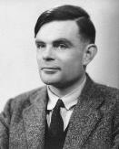
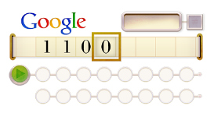
Alan Turing
One of the greatest computer scientists and computational theorists
Complexity analysis is part of computational theory
Often called the father of modern computing
Some famous things
Turing award (圖靈獎)
Nobel Prize of computing
Turing machine (圖靈機)
Theoretical computer model
http://www.google.com/doodles/alan-turings-100th-birthday
Turing test (圖靈測試)
Test of a computer’s ability to exhibit behavior equivalent to human

Slide 165
Common Big O Hierarchy
n!
exp.
cubic
O(n!) factorial
O(2^{n}) exponential
O(n^{k})
…
O(n³) cubic
O(n²) quadratic
O(nlog(n)) log-linear
O(n) linear
O(n^{0.x}) sub-linear
O(log(n)) logarithm
O(1) constant
quadratic
…
const.
O(n²) algorithms/problems are also O(n³) ones, and so on
Many other classes are not listed here, e.g., O(n^{1.5}), O(loglog(n)), O(nlog²(n))…
O(1) means that the execution time is independent of problem size
E.g., time for retrieving the k^{th} entry of an array (of size n) is O(1)

Slide 166

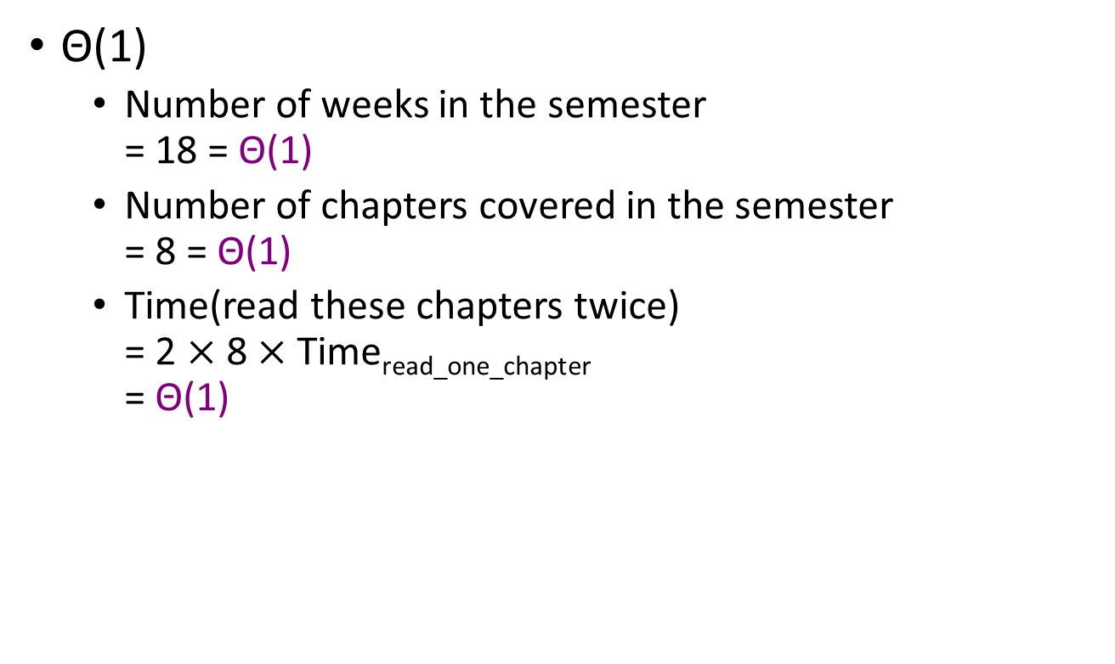
Time Complexity of Learning DS
Θ(1)
Number of weeks in the semester = 18 = Θ(1)
Number of chapters covered in the semester = 8 = Θ(1)
Time(read these chapters twice) = 2 $×$ 8$×$Time_{read_one_chapter} = Θ(1)

